Slide 1
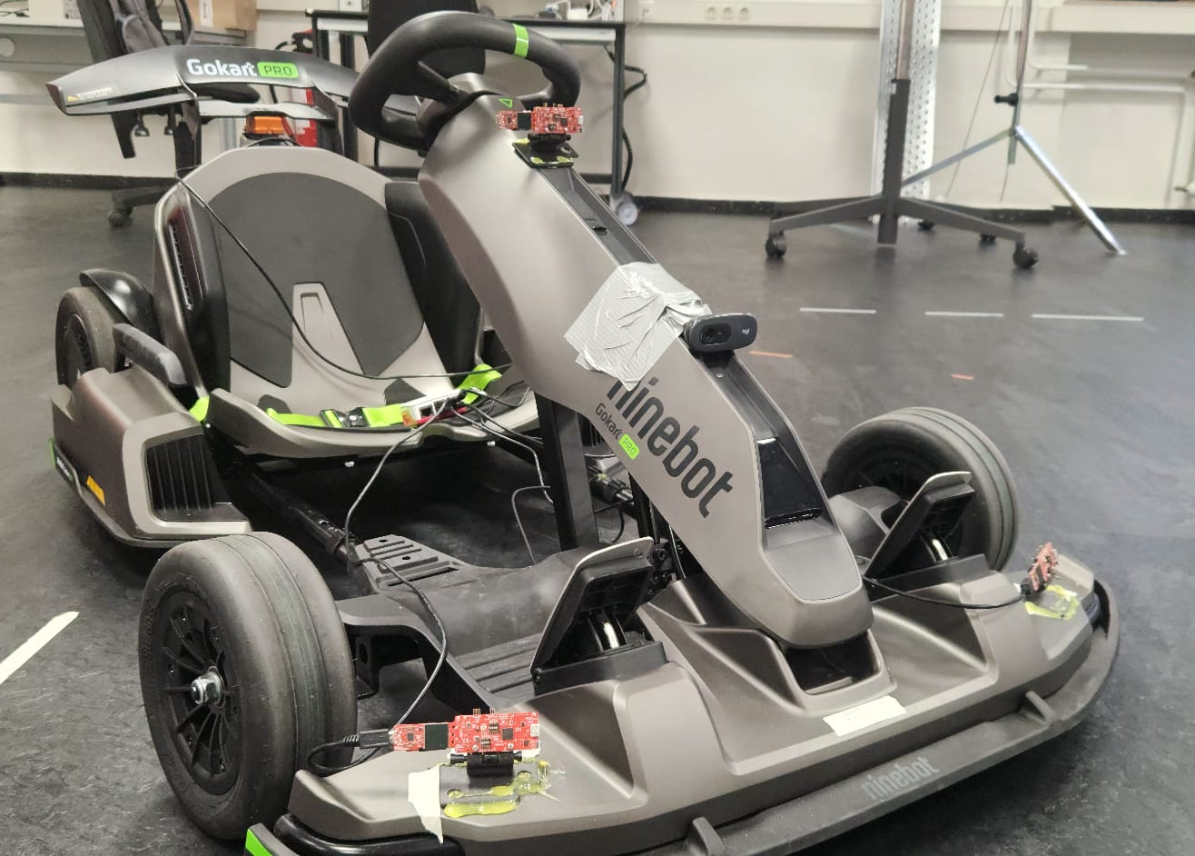
Radar odometry using mmWave technology for SLAM applications.
Radar-based Ego-Motion Estimation.
Author:
Luis Fernando Rodriguez Gutierrez
Supervisor:
Prof. Dr. Andreas Becker
Co-Supervisor:
Tobias Uhlich

Slide 2
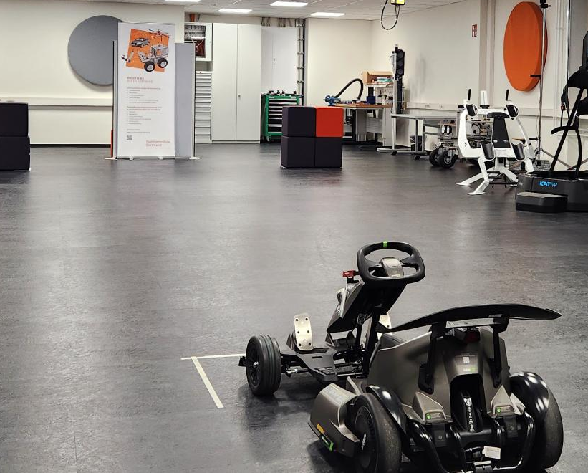
Project Overview
This project investigates radar-based ego-motion estimations using mmWave sensors and inertial measurements units (IMU) as foundation for autonomous navigation and SLAM.
The focus is on deriving vehicle motion (translation and rotation) from sparse point clouds, enhanced by Doppler and IMU data. This while keeping compute and sensor cost practical for embedded use.
Notes:
We aim for odometry first. SLAM is a later application

Slide 3
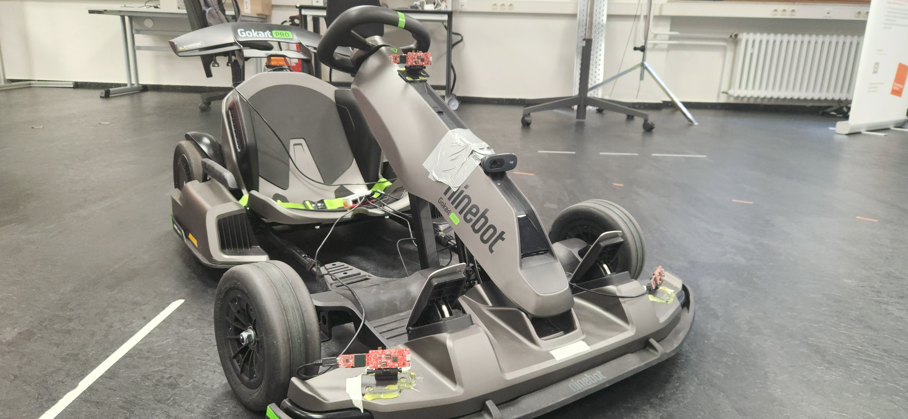
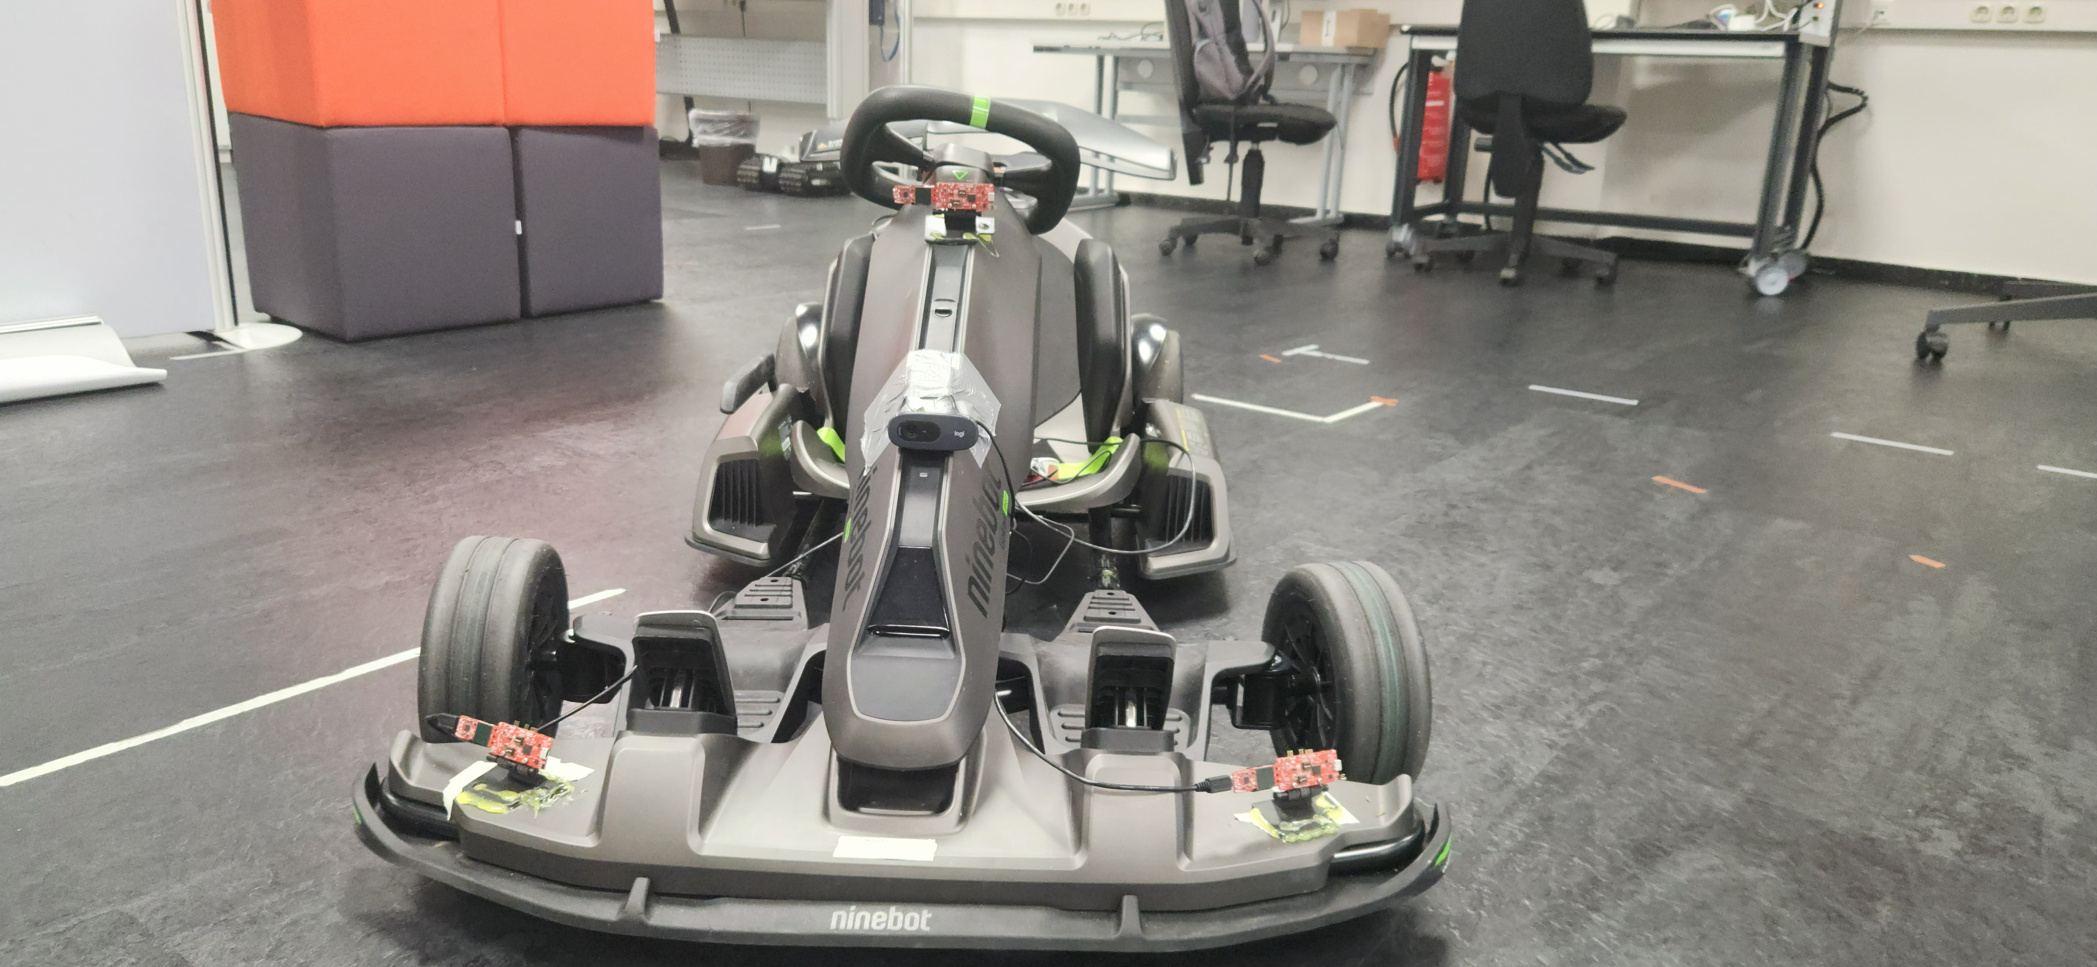
Hardware Setup
Ninebot Gokart PRO
Max. Speed: 40 km/h.
Max Distance: 25 km.
Max Acceleration: 1,02 G.
Drift-Assistance System.

Slide 4
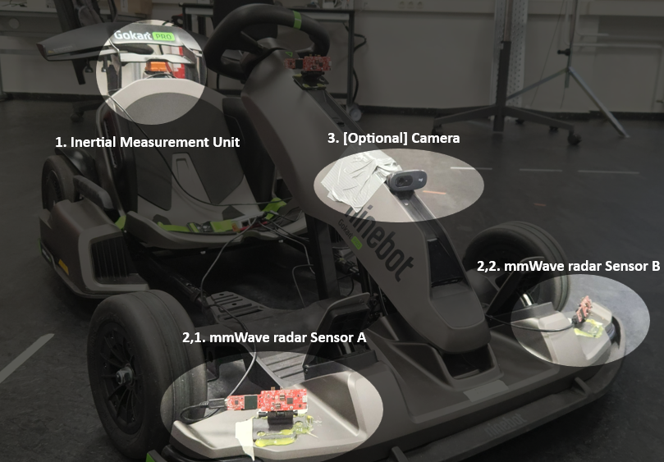
Hardware Setup
Sensors used for the project:
MTi-710, Inertial Measurement Unit.
IWR6843AOP, mmWave radar sensor.
Logitech C270 HD, Camera.

Slide 5
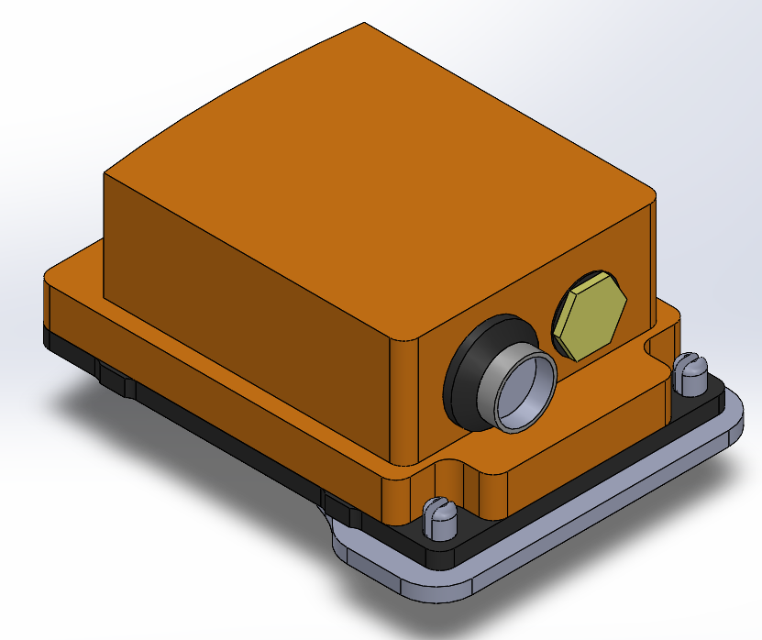
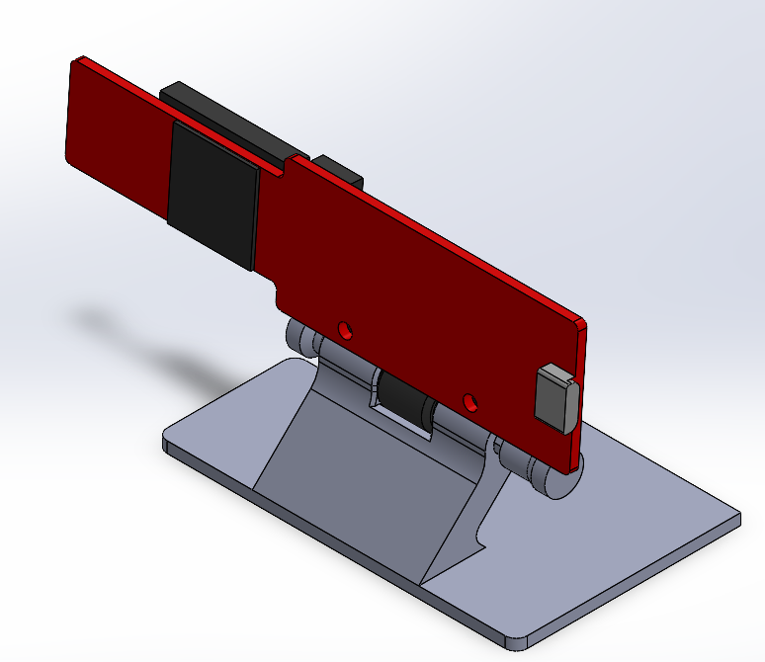
Hardware Setup
To securely integrate the sensors into the vehicle, custom 3D-printed mounts were designed.
Each mount ensures an optimal alignment and positioning of the sensors to maintain consistent measurement geometry.
The models were developed in CAD to ensure the following points:
MTi-710, ensure close to no tilt to the sensor to avoid post processing.
IWR6843AOP, ensure stability when mounted and possibility to tilt the sensor to modify the field of view.

Slide 6
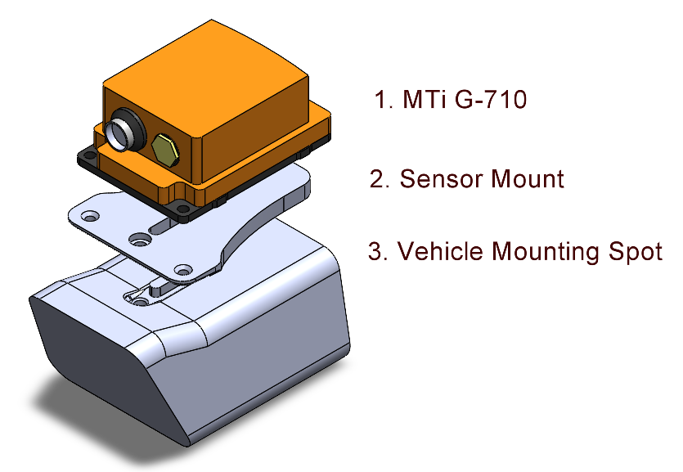
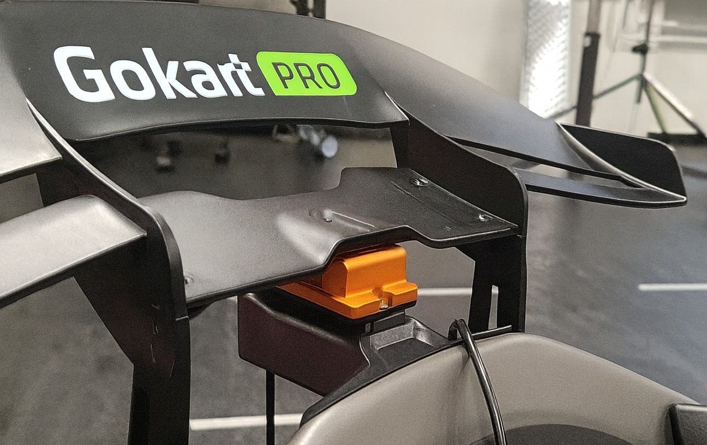
Hardware Setup MTi-710
The integration of the IMU was an interesting one. As the nature of the IMU is to measure the inertia and rotation, the mounting of this sensor is crucial. Depending on the position a post-processing needs to be done to ensure accurate measurements or place it in an “ideal” position. For this vehicle the ideal place was found, however it needed a unique mount for the vehicle.

Slide 7
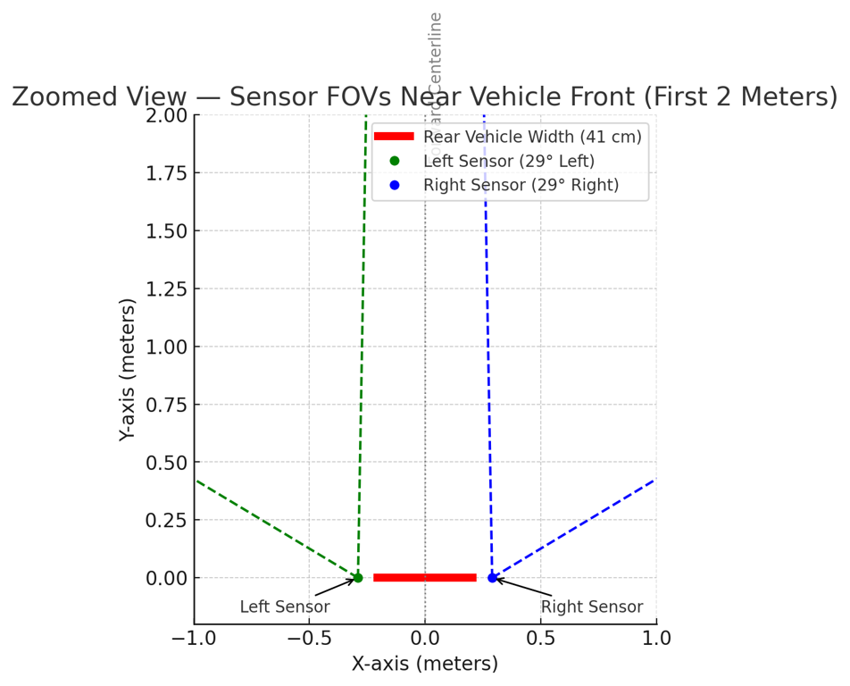
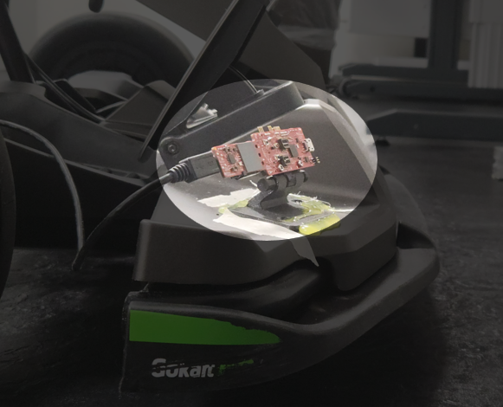
Hardware Setup IWR6843AOP
Mounting geometry:
Tilt: 15°
Yaw: 29°
Displacement: 58 cm.

Slide 8
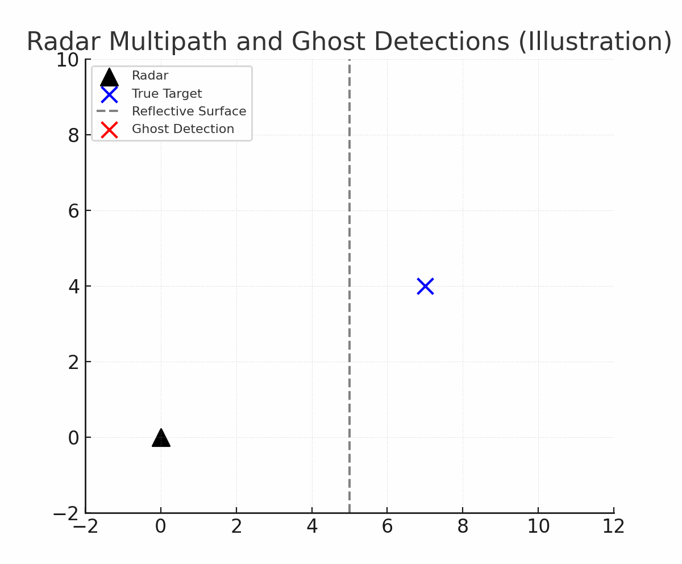
Problem Definition. Limitations of Radar for Odometry.
Sparse point clouds.
Radar detects only a few reflections per computed frame. Meaning weak geometric of non reflective material will not be easily detected.
Multipath and clutter.
Indirect reflections from metallic or smooth surfaces create ghost points or unreliable doppler detections.
Measurement noise.
Low SNR and range quantization cause unstable point locations and Doppler outliers.
Dynamic scenes.
Moving objects introduce inconsistent detentions between frames.

Slide 9
Problem Definition. Limitations of Radar for Odometry.
Sparse point clouds.
Radar detects only a few reflections per computed frame. Meaning weak geometric of non reflective material will not be easily detected.
Multipath and clutter.
Indirect reflections from metallic or smooth surfaces create ghost points or unreliable doppler detections.
Measurement noise.
Low SNR and range quantization cause unstable point locations and Doppler outliers.
Dynamic scenes.
Moving objects introduce inconsistent detentions between frames.

Slide 10
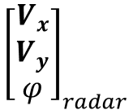
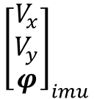
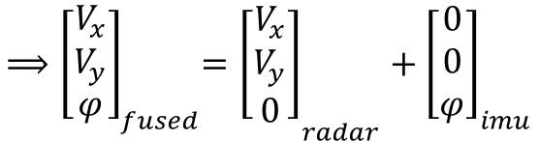
Project Overview
Why mmWave + IMU?
Environmental robustness: Operates reliably under adverse conditions, such as rain.
Doppler advantage: Directly measures radial velocity, reducing ambiguity in motion estimation.
Inertial support: IMU provides pose estimates complementing radar’s data.
Combined benefit:
Radar provides accurate translation.
IMU provides consistent rotation.
and

Slide 11
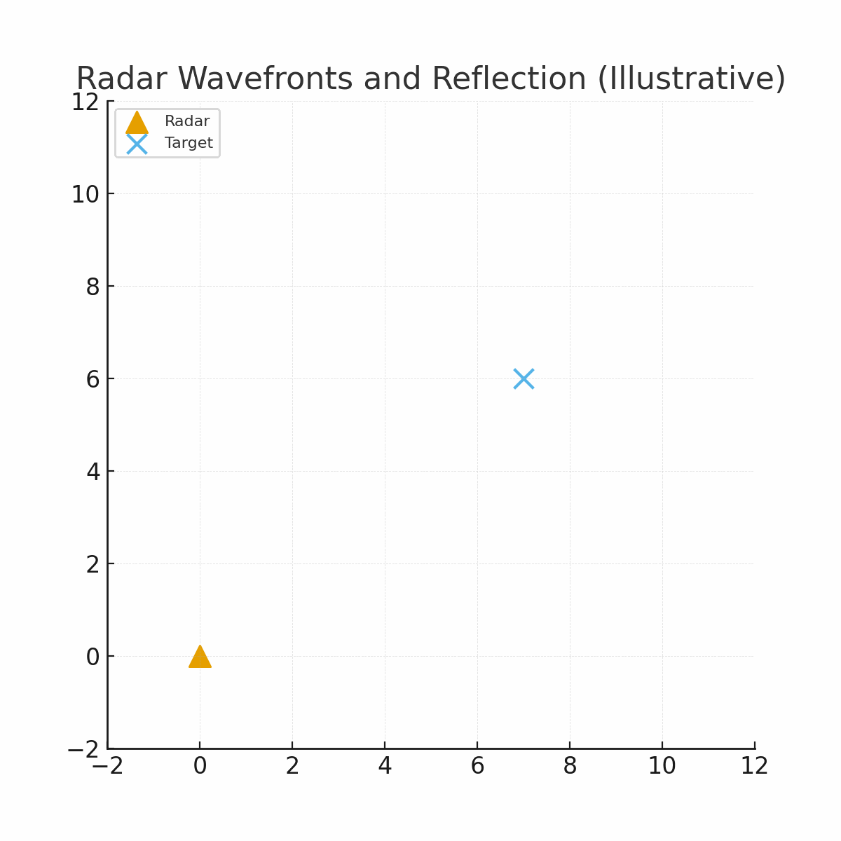
Problem definition

